Slide 1

Group 27 - Based
Bitcoin Core
Concrete Architecture
Amy Cui, David Courtis, Jagrit Rai, John Alajaji ,Logan Cantin, Matthew Vandergrift
https://youtu.be/55YOnoDALWM

Slide 2
Team
John Alajaji
(Member)
Report: Introduction, Derivation Process, Conceptual Architecture of Overall System, Concrete Architecture of the Overall System, Lessons Learned, Conclusion, Abstract, Dependencies of Subcomponent, Peer Discovery Use Case
David Courtis
(Presenter)
Report: Mapping / Creating 2nd Level Concrete + Reflexion Analysis.
Presentation / Script: Introduction, derivation process, considered alternatives, 2nd level concrete architecture + reflexion, concurrency and Team Issues, Limitations & Lessons, Use Case, Conclusion.
Jagrit Rai
(Presenter)
Report: Conceptual Architecture Modified Components, Conceptual and Concrete Modified Dependencies, Unsolicited Block Push Use Case
Presentation: Script modification
Logan Cantin
(Member)
Report: Modified Dependencies, P2P Network Interface Reflexion Analysis, P2P Conceptual Architecture, P2P Dependencies, Sequence Diagram
Amy Cui
(Team Leader)
Report: P2P Network Interface Reflexion Analysis, Start of Peer Discovery use case
Presentation: Slide formatting, Concrete Architecture, Subsystem Investigation, Reflexion Analysis - 2nd Level, Lessons and Limitations
Matt Vandergrift
(Member)
Report: Abstract, Conceptual Overview, Unexpected dependencies. Modified components for conceptual. Divergent dependencies. Concrete specific components. Lessons Learned.
Presentation/Script: Concrete vs Conceptual, Derivation, modified components, new dependencies, divergences, and concrete components

Slide 3
01 Introduction 02 Derivation
03 Conceptual Architecture Overview 04 Updated Components
05 Concrete Architecture
06 Modified Components and Dependencies
07 Subsystem Investigation of the P2P Network Interface -> Subsystem Investigation -> Conceptual Architecture -> Concrete Architecture
08 Reflexion Analysis - 2nd Level
09 Use Case Analysis
10 Effects of Concurrency and Team Issues
11 Limitations and Lessons Learnt
12 Conclusion

Slide 4
01.
Introduction

Slide 5

Concrete Architecture refers to the relations and dependencies that actually exist in the system.
Reflexion analysis is the process of bringing a conceptual architecture into line with a system’s concrete architecture.
This presentation will focus on the concrete architecture of bitcoin core, along with the reflexion analysis process which was undertaken to bring the conceptual into line.
Concrete vs Conceptual

Slide 6
02.
Derivation and Alternatives

Slide 7
Derivation Process
Feedback from the TAs, Meetings with Professor, and reading of relevant papers on Reflexion Analysis
Mapping of files to the updated conceptual architecture
Investigation of the dependency graph in understand
Analyse gaps between concrete architecture and
Conceptual, updating the conceptual where appropriate

Slide 8
Chosen Arch. / Alternatives
Our previously chosen architectural styles represented the system adequately. Added:
Object Oriented:
Dense interconnectedness of our components
Pub/Sub:
Need to relay real-time events within the software and host

Slide 9
03.
Conceptual Architecture Overview

Slide 10
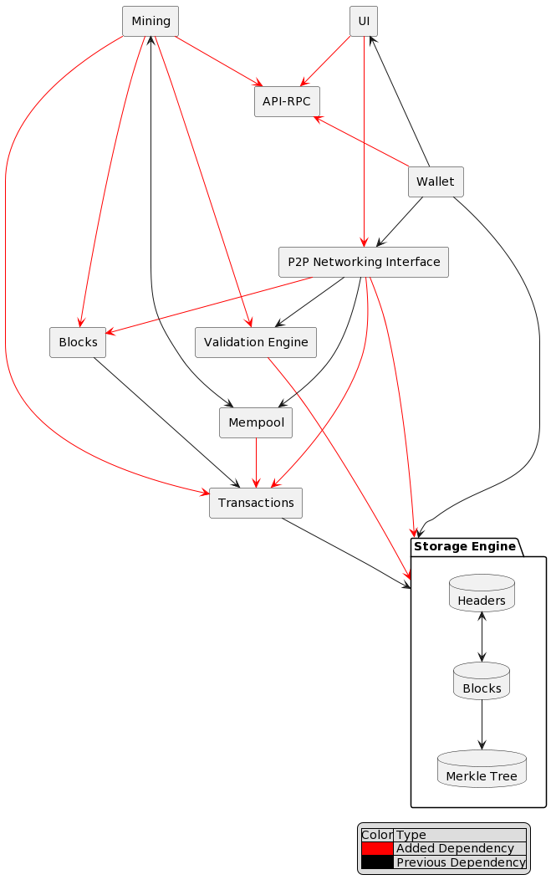
Updated Components based on feedback from last assignment, and from based on the process of brining conceptual into line with concrete.
Updated Dependencies based on a greater understanding of the overall system, achieved via reflexion analysis
Architecture of a given node

Slide 11
04.
Updated Components

Slide 12
Modified Components/ Dependencies
API-RPC
P2P
Transaction
Mining
API-RPC
Storage Engine
Block
Validation
Storage
UI
Wallet
Validation Engine

Slide 13
Validation Engine
Ensures the consistency and correctness of the data being handled in the system.
Narrower responsibilities, shifted some responsibilities to the peer to peer interface.
Current Responsibilities
Ensuring Validity of a block
Ensuring validity of a transaction.

Slide 14
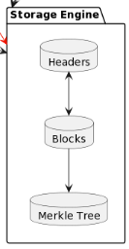
Storage Engine
Responsible for managing the storage and retrieval of all data related to the bitcoin network.
Contains databases for transactions, blocks, merkle trees/roots, and other network data.
Similar, although modified, to the blockchain component in our previous conceptual architecture.

Slide 15
API-RPC
New component not found in previous architecture, which was recommended by TAs.
Application Programming Interface-Remote Procedure Call.
Allows developers to interact with the system, in a more advanced fashion than simple end users
Also provides functionality to the node, hence used by certain subsystems
E.g Mining

Slide 16
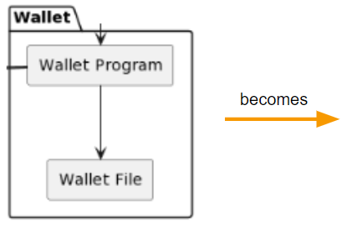

Wallet
Used to be wallet program and file merged into one
Contains keys used to sign transactions
Interacts with the storage engine which is expected

Slide 17
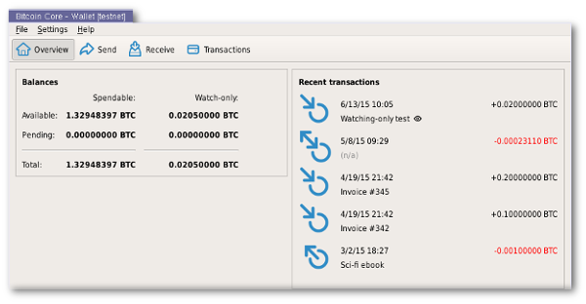
User Interface
The UI used to just be a wallet UI, but now it is general purpose UI
Connections between all other components infomed this decision

Slide 18
New Conceptual Dependencies
In the report we include a full and comprehensive rundown here is a short selection of some which are instructive for understanding the updated conceptual architecture.
P2P → Block:
No longer distinguish block construction and block as components, and blocks are delivered to the Network.
Mining → API-RPC:
API-RPC is not only used by outside programmers but also by components of the system.
Validation Engine → Storage Engine:
The validation engine verifies not only incoming objects but also stored objects inside the node.
Mining → Transaction:
Miner interacts with transaction data – Transaction should be its own component since it cannot be fully encapsulated by the block.

Slide 19
05.
Concrete Architecture

Slide 20
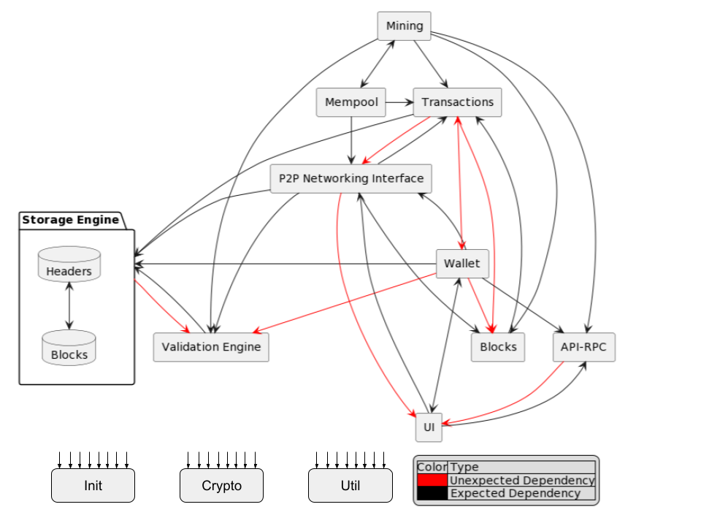
Key Differences:
More Components. Much greater degree of connections. Everything depends on the Crypto component. Util, Init added for shared tools.
Divergences:
Many unexpected connections, but no missing ones.
Explored next…
Note that disconnected arrows represents connections to all other components.

Slide 21
06.
Reflexion Analysis - Top Level

Slide 22
Divergent Components
Util (Utility)
A common component for functions and data types used by a wide of variety of other components.
Init
Component which sets up the whole system
Blocks
Block itself and operations != database management
Transaction
Transaction structure != database management

Slide 23
Divergent Dependencies
Wallet → Block. We suspected that the wallet simply dealt with keys however it is clear that the wallet gathers block information for backup purposes. (backup.cpp)
Wallet → Transaction. It was not expected that the wallet handled any transactions, however it does handle them. It handles partially signed transactions with functions PSBTInputSigned, PSBTinput, PartiallySignedTransaction,SignPSBTInput, FinalizeAndExtractPSBT, etc
Transaction → Wallet. It was not anticipated that transactions when created used data from the wallet such as Camount, and MAX_AMOUNT which are crucial constants.
Transaction → P2P. Transformation need information about nodes which originate it, which is found in P2P. Gives idea about specific data used to support transactions,with function NodeID
Storage Engine → Validation Engine. The storage engine needs to understand the rules which govern blocks and transactions. Uses (m_blockman from validation)
Note: A full rundown of unexpected dependencies can be found in report, important ones explained here.

Slide 24
07.
Subsystem Investigation
P2P Network Interface

Slide 25
Subsystem Investigation
P2P Network Interface
Analysis Flow
Main focus:
communication between peers within a peer to peer network
Includes:
Peer Discovery and Maintenance
Sending Transactions or blocks to other peers
Conceptual:
Explore our initial conceptual and concrete architecture
Concrete:
Find the divergences we’ve observed through reflexive analysis.

Slide 26
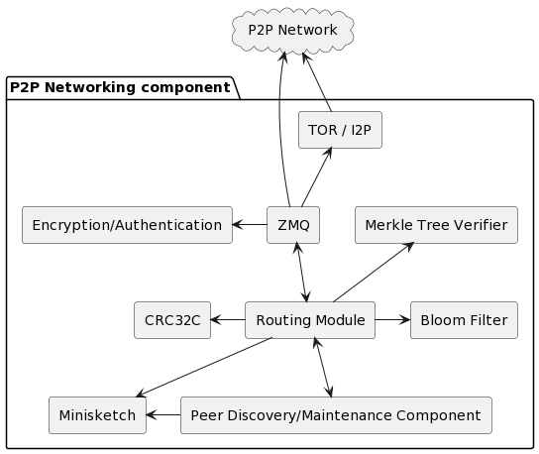
Conceptual Architecture
Zero Message Queue (ZMQ):
Publisher / subscriber messaging system.
Routing Module:
Routing, receiving, and transmitting of data.
Peer Discovery and Maintenance:
Peer discovery, malicious peers, avoiding DoS, and ignoring bad actors.
TOR and I2P:
Connect to the P2P network more anonymously.
Bloom Filter:
Partially hide transactions of interest from peers.
Authentication and Encryption:
Secures and encrypts connections between peers.
CRC32C
Error detection in data transmission and storage.
Merkle tree verifier:
Verify transactions using tiny bandwidth through p2p.

Slide 27
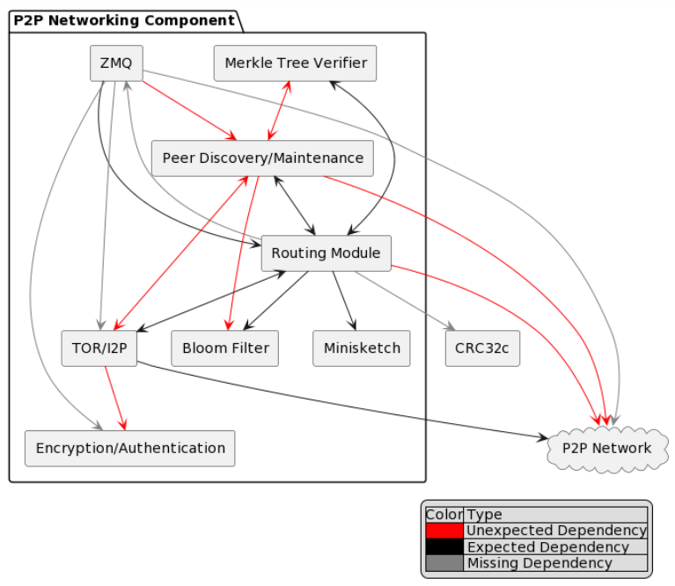
Concrete Architecture
Convergences:
Conceptual components were able to cleanly represent the Peer to Peer Network Interface Component
Divergences:
ZMQ component was misunderstood - does not deal with P2P communication or the underlying network protocols.
Many vacant or unexpected connections.
Explored next…

Slide 28
08.
Reflexion Analysis - 2nd Level

Slide 29
Divergent Dependencies
Heightened interconnectivity of the Peer Discovery and Maintenance
ZMQ → Peer Discovery and Maintenance:
arises due to zmqpublishnotifier.cpp file, which is used to specify the IPv6 address format in the error message when there is a problem with the ZMQ socket binding.
Peer Discovery and Maintenance ↔ Merkle Tree:
prevents nodes from being misled by malicious peers that may provide invalid block headers
TOR I2P ↔ Peer Discovery and Maintenance:
security files of TORP are linked to PDM file net*.cpp. These files help provide secure and anonymous communication channels between peers
Peer Discovery and Maintenance → Bloom Filter:
When a peer receives a Bloom filter-related message, it needs to process and respond to the message accordingly and interacts with the peer discovery and maintenance components to ensure that the communication is managed correctly, and with the ban manager to penalize any misbehaving nodes.

Slide 30
Divergent Dependencies
Reduced ZMQ interconnections, and Others
ZMQ ↛ TOR I2P/P2P Network:
ZMQ does not deal with P2P communication or the underlying network protocols
ZMQ ↛ Encryption Authentication:
integration of BIP-150 and BIP-151 in future for security enhancement of node connection
Routing Module ↛ ZMQ:
represents only the messaging infrastructure for real-time events such as new transactions or blocks within Bitcoin Core
TOR I2P → Encryption Authentication:
provides the necessary SHA256 hashing functions which are used in the TorController::AuthDone() method to generate the onion address of the hidden service.
Routing Module ↛ CRC32C:
error detection spread throughout over multiple net*.cpp files which verify that the checksum for a given payload is valid

Slide 31
09.
Discovery of Peers
Use Case Analysis

Slide 32
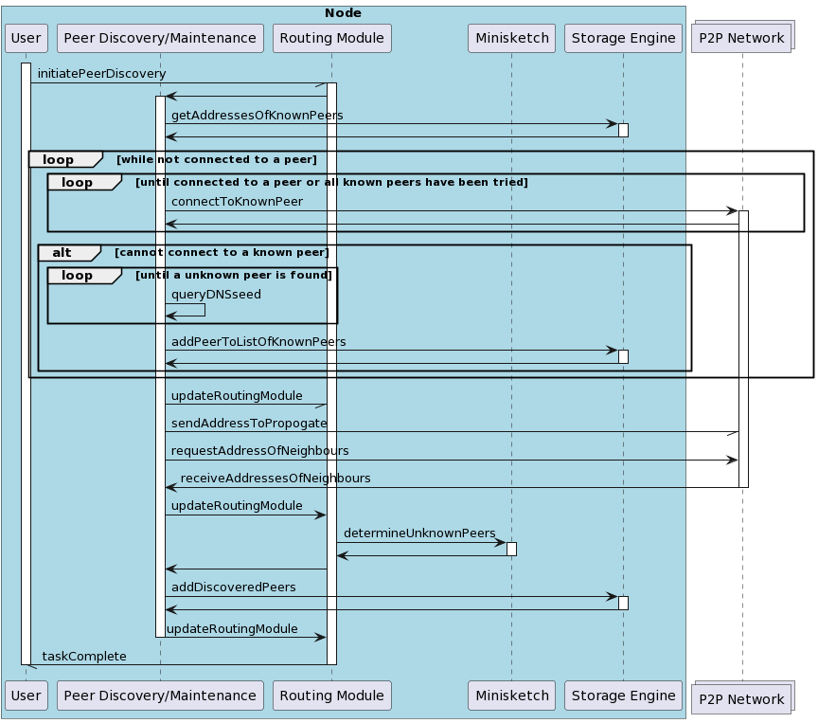
Peer Discovery Over Clearnet
Node initiating the peer discovery has at least one known peer, and is running over clearnet
Node to Peer Connection:
first will try connecting to its known peers, but if this fails will result to querying DNS seeds to find some other peer.
New IP Propagation:
After connecting, will send its IP address, as well as request the IPs of the peer’s neighbours
Minisketch Set Difference:
Retrieve only the unknown addresses, which will be stored by the storage engine.

Slide 33
10.
Effects of Concurrency & Team Issues

Slide 34
Concurrency & Team Issues
Concurrent Development
Limitations
Branches:
Tags are created regularly from release branches to indicate new official, stable release versions of Bitcoin Core
Workflow:
The contribution workflow is described in the github’s CONTRIBUTING.md and doc/developer-notes.md.
Bottlenecks:
Testing and code review is the bottleneck for development.
Solutions:
Developers are strongly encouraged to write unit tests for new code, and to submit new unit tests for old code

Slide 35
11.
Lessons Learned
And Limitations

Slide 36
Lessons and Limitations
Lessons
Limitations
Work Involved:
Greatly underestimated (reach out to the TA and Professor sooner)
Cyclic Reflexion Analysis:
Cannot be parallelized, and must be done sequentially. Must make small changes to continuously iterate through the process
High Number of Contributions:
Difficult to push through reflexive analysis at a high speed when considering total system evolution.
Rigorous documentation:
Only a fraction of the discussed dependencies had an existing rationale written down. Lost time.

Slide 37
12.
Conclusion

Slide 38


Conclusions
Statements:
Far from a trivial task. Parsing all available documentation helped bring out previously proposed conceptual architecture into line with the concrete architecture of Bitcoin Core.
Contacts:
Amy Cui (19ayc1@queensu.ca)
David Courtis (20dhc@queensu.ca)
Jagrit Rai (19jr28@queensu.ca)
John Alajaji (18ja19@queensu.ca)
Logan Cantin (logan.cantin@queensu.ca)
Matthew Vandergrift (19mwv1@queensu.ca)

Slide 39
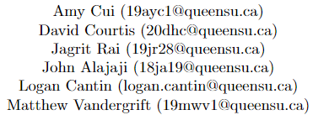
Thank you
Any Questions?

